Slide 1
AWS Application Deployment
Applied AI with Azure
Razin Bin Zaidun

Slide 2
Agenda
Introduction to Azure Speech to Text, Language Service & Function App
How Azure STT, Language Service & Function App works
Why use Azure STT, Language Services & Function App
Cost Optimization
Summary & Recommendation

Slide 3
Introduction

Slide 4

What are the services?
Azure Speech to Text
Azure Speech to Text accurately transcribes spoken language for voice-driven and transcription applications.
Language Service: Summarizer
Language Service enables sentiment analysis, entity recognition, and language understanding using NLP.
Serverless Compute Integration: Function App
Azure Function App provides serverless compute for running code without managing infrastructure, ideal for automation.

Slide 5
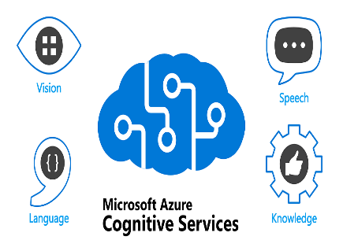
How it works
Audio Input Processing
Audio input is captured from users or devices and converted into text using advanced speech-to-text technology.
Language Analysis Service
Textual data is analyzed to extract insights like intent, sentiment, and key phrases for deeper understanding.
Workflow Orchestration
Azure Function App manages the workflow, triggering actions based on analyzed data for real-time and scalable processing.

Slide 6

Why Use Azure Services
High Accuracy and Multilingual Support
Azure STT and Language Services deliver high accuracy and support multiple languages for diverse global applications.
Seamless Azure Integration
These services integrate smoothly with the Azure ecosystem, allowing easy development of end-to-end solutions.
Serverless Flexibility with Function App
Function App provides serverless execution, reducing overhead and enhancing cost efficiency for developers.
Enhanced Productivity and Scalability
Together, these benefits improve productivity, scalability, and user experience for modern enterprises.

Slide 7

Cost Optimization
Optimized Pricing Tiers
Selecting suitable pricing tiers for speech and language services based on usage reduces unnecessary expenses.
Serverless Execution
Using Function App for serverless execution minimizes infrastructure costs by charging only for compute time used.
Auto-Scaling Resources
Auto-scaling ensures efficient resource allocation, preventing over-provisioning and reducing costs.

Slide 8
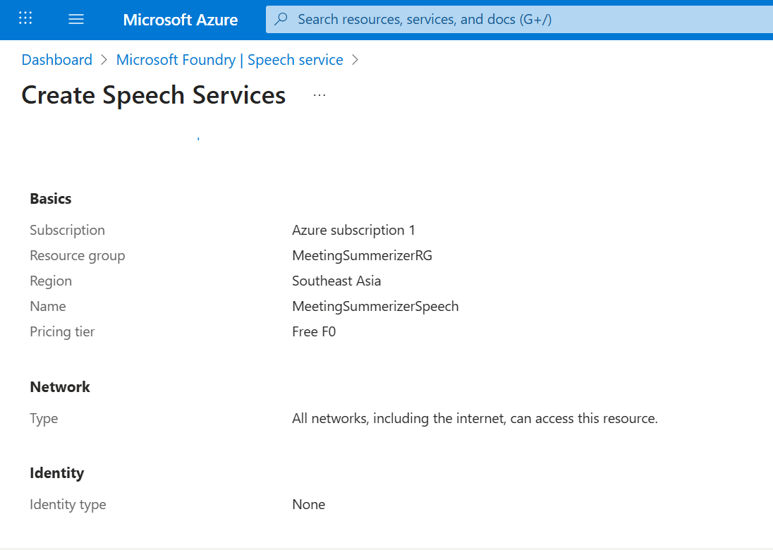

Slide 9
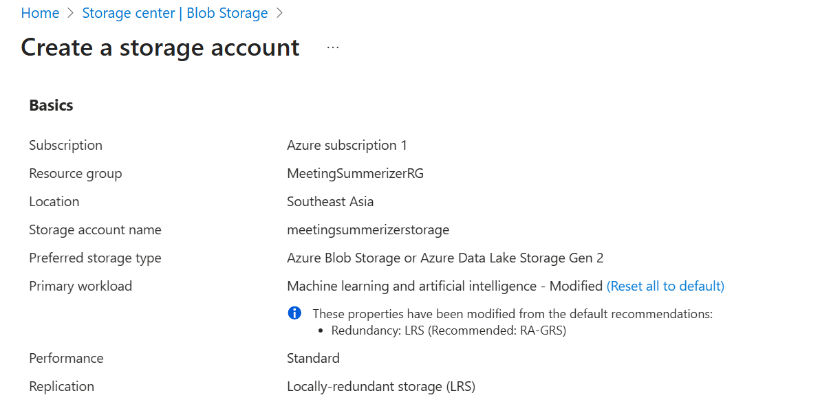

Slide 10
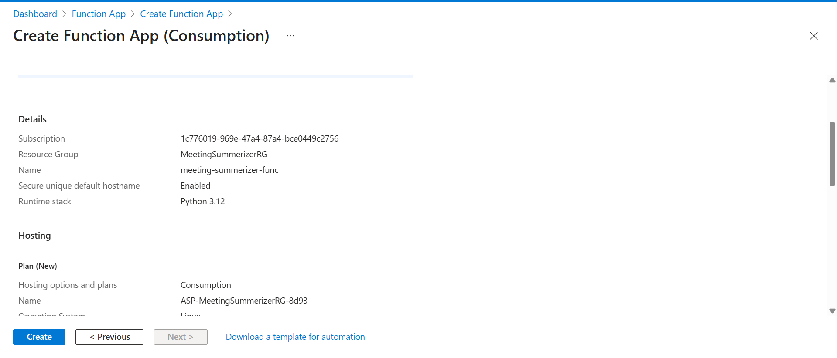

Slide 11
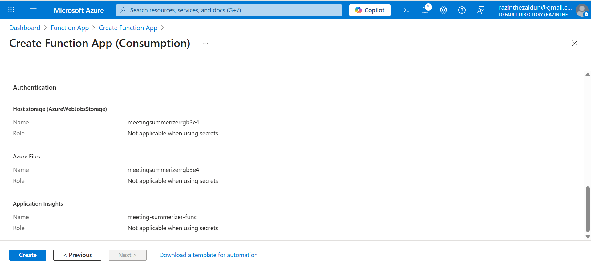

Slide 12
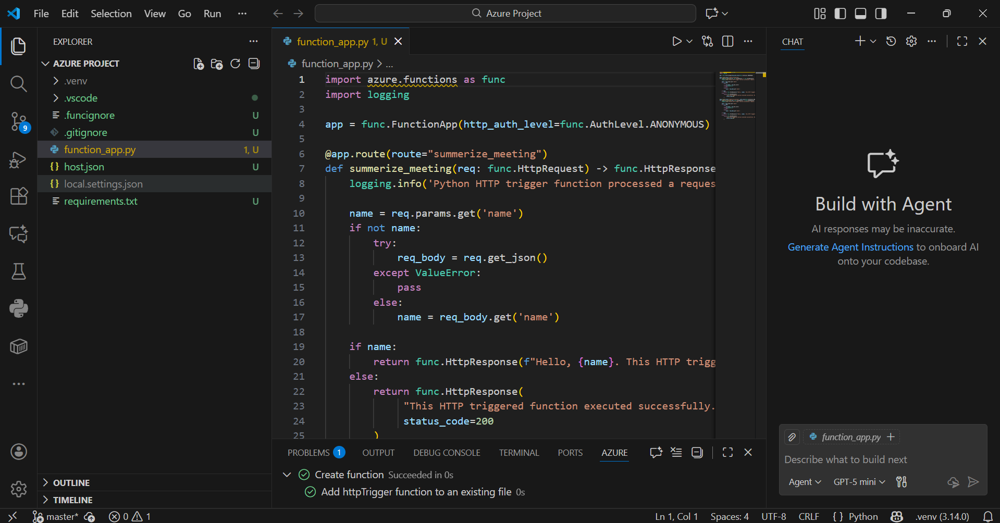

Slide 13
Activity Flow

Slide 14
Activity Flow

Slide 15
Deployment Challenges and Solutions

Slide 16

Challenges
Local Testing
Initial attempts to run the Azure Function locally failed. The virtual environment was missing critical dependencies for connecting to the Azure services and simulating the Azure runtime. Postman also had errors communicating to the Azure resources due to how the resources were being accessed.
Overcoming it: Deleting and reinitializing the virtual environment allowed for a clean slate to work on and allowed me to properly install the required dependencies.

Slide 17
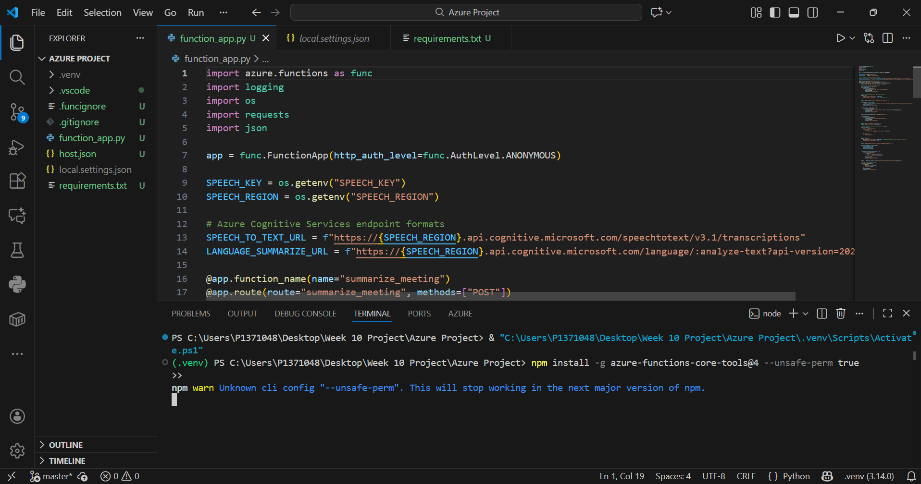

Slide 18
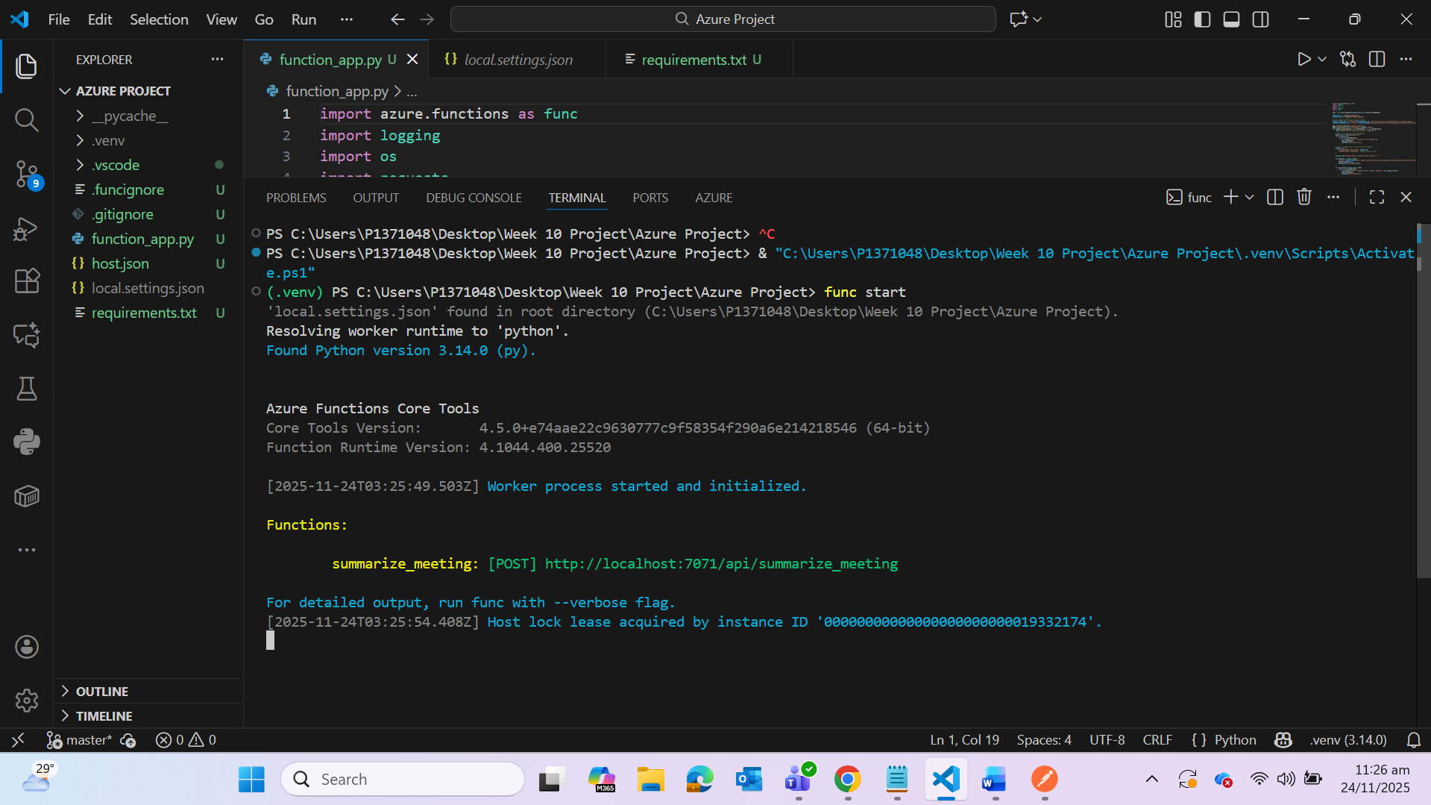

Slide 19
Challenges
API Payload for Language Service
Communication after to the Language Service, particularly the summarizer feature, had failed multiple times. Azure Language Service expects a JSON or transcript document type format to process and present an output. The Speech to Text output was ultimately just a string of words with no construct or format.
Overcoming it: After the STT had processed and generated its output, creating and initializing a strict format that the API can recognize was what I did to resolve the error of the failed communication.

Slide 20
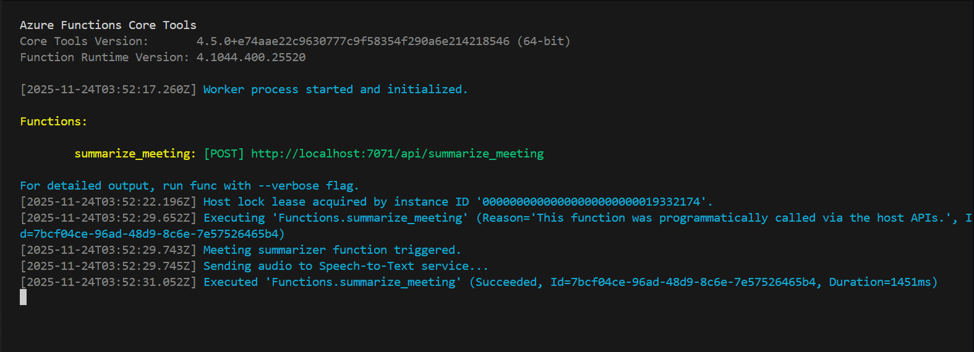

Slide 21
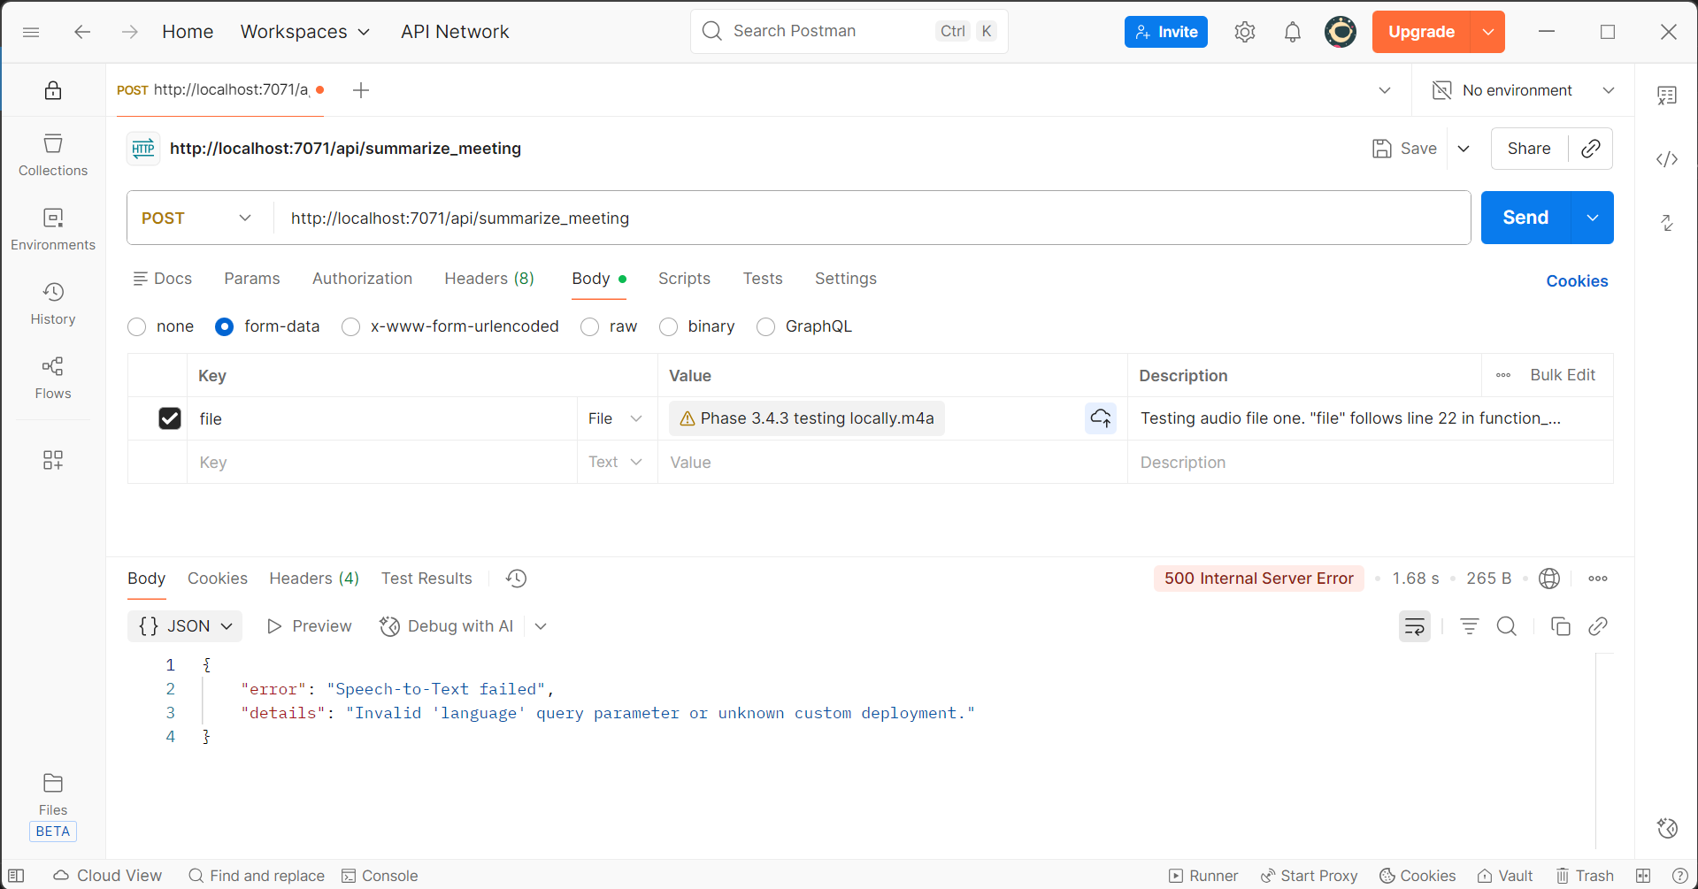

Slide 22
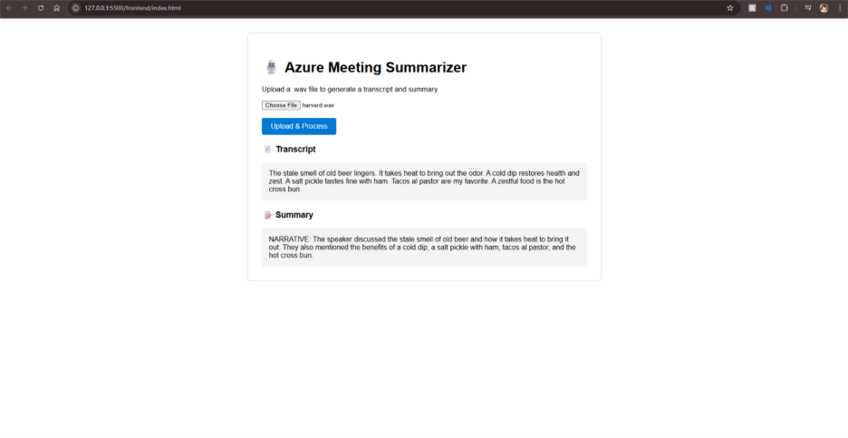

Slide 23
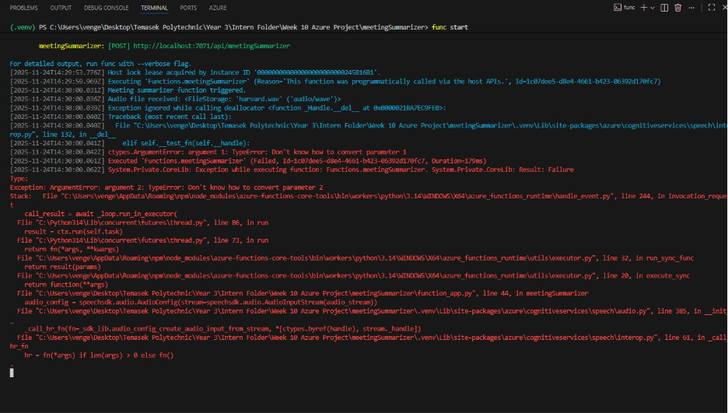

Slide 24
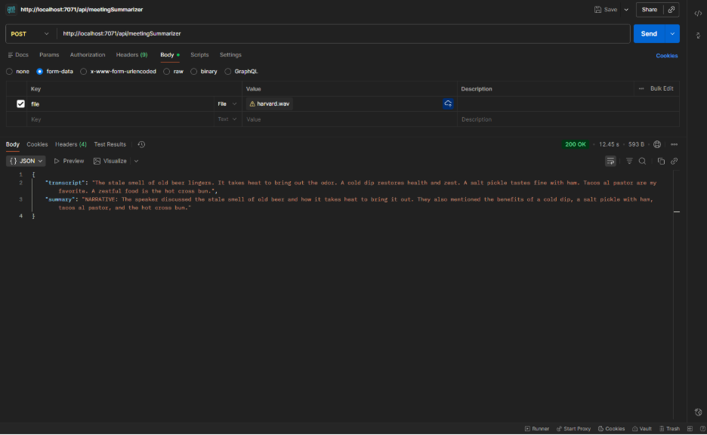

Slide 25
Challenges
File path issue
The Azure Speech SDK requires a physical file path to process audio. However, Azure Functions run in a read-only environment where standard file saving is restricted. Solution
Implemented a tempfile module to create temporary files in the system’s temporary directory. This ensures the SDK can still access the stream without violating cloud permission policies.

Slide 26
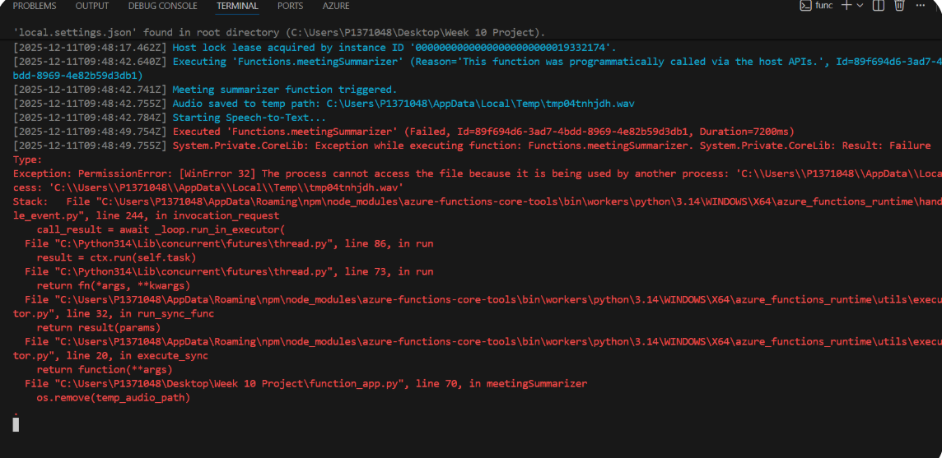

Slide 27
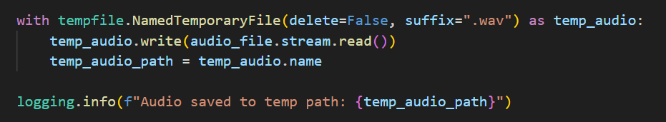
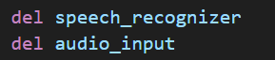

Slide 28
Challenges
CORS Connectivity
Deploying from Localhost to Azure cloud broke the communication between frontend and backend. Solution
Created a static website from the Azure Storage Account and allowed the static URL within the Function App CORS setting.

Slide 29
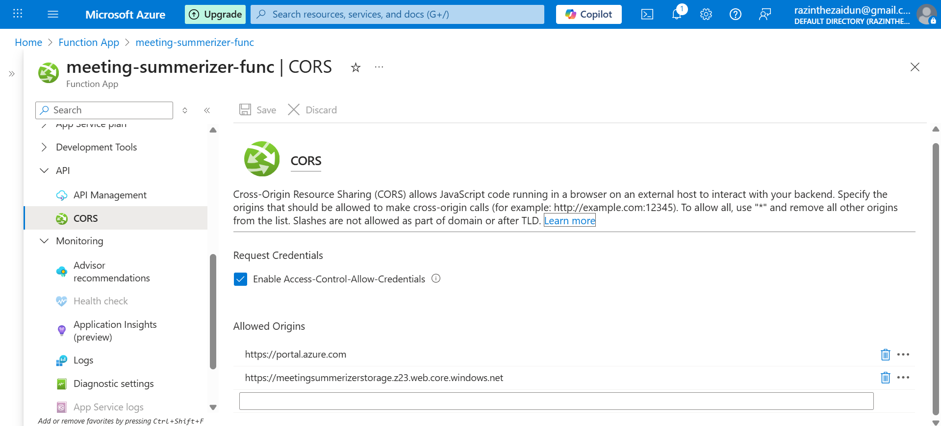

Slide 30
Challenges
Frontend Development
Frontend was a very plain and simple design. Solution
Changed to a React + Vite based frontend for fast and efficient frontend development. Used axios for more simplified API requests and response without excess code.

Slide 31
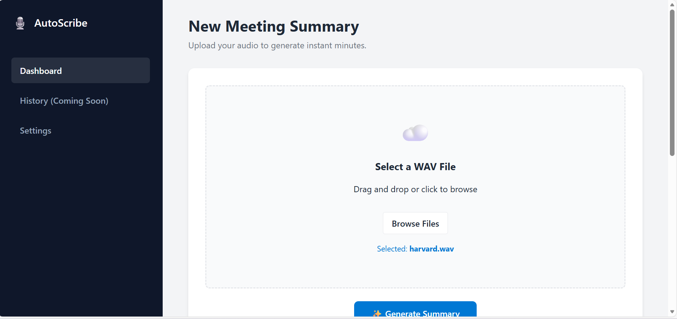

Slide 32
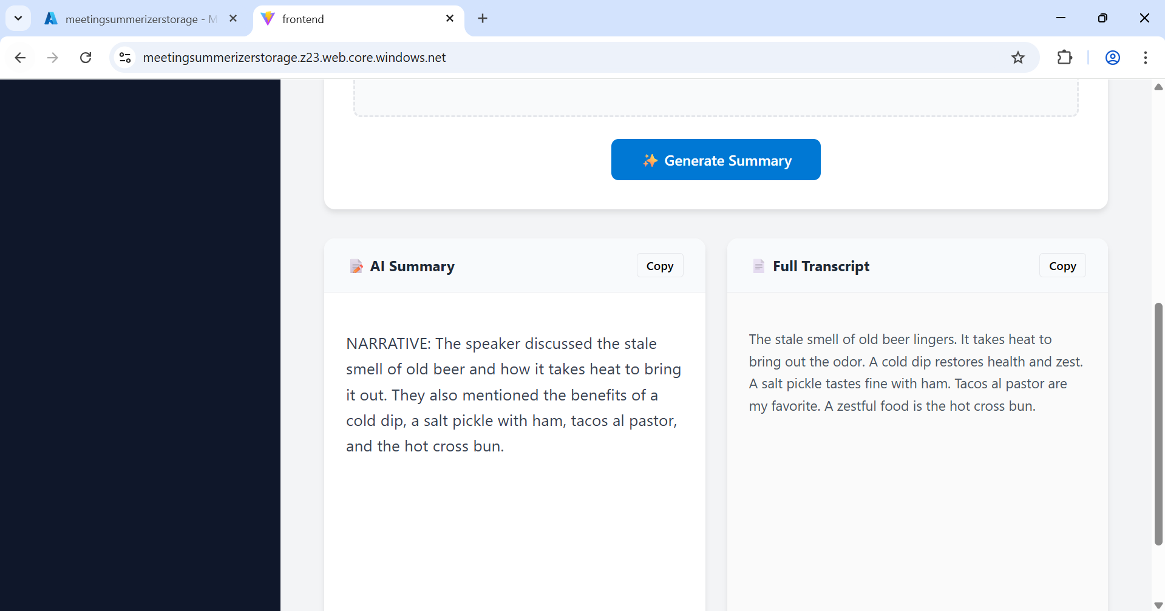

Slide 33
Learning & Takeaways

Slide 34
Learning & Takeaways
Area | What I Learned | Impact
File System Constraints | Cloud functions are ephemeral. Depending on local file paths is an anti-pattern; utilizing tempfile or memory streams is mandatory. | Prevented “Permission Denied” crashes in production.
CORS | Browser security is strict. Backend APIs must explicitly allow specific frontend domains, and protocol (HTTP vs HTTPS) mismatches cause silent failures. | Ensured secure and reliable API communication.
Deployment Parity | Local settings files (local.settings.json) are not uploaded automatically. Cloud configuration must be managed as a separate, deliberate step. | Reduced deployment debugging time by 50%.

Slide 35
Summary and Recommendations

Slide 36
Summary
Full-Stack Implementation
Successful integrated a Python Serverless Backend with a modern React Frontend, demonstrating end-to-end cloud development capability.
Resilient Architecture
By solving file-locking and CORS issues, the application is now robust enough to handle real-world user traffic without crashes.
Scalable Foundation
The project is deployed on auto-scaling Azure resources, ready for future enhancements like history tracking and multi-language support.
Recommended Solution​
This project proves that Azure's "AI-as-a-Service" model is an ideal solution for organizations seeking to automate manual documentation tasks with speed, accuracy, and minimal overhead.

